Slide 1



SOFTWARE DEVELOPMENT PROFESSIONAL PROGRAM
Collaboration on GitHub

Slide 2





Collaboration on GitHub
Learning Objectives
Describe the benefits of using GitHub or similar tools.
Describe the difference between a local file and a remote file.
Fork and clone an existing code project on GitHub.

Slide 3
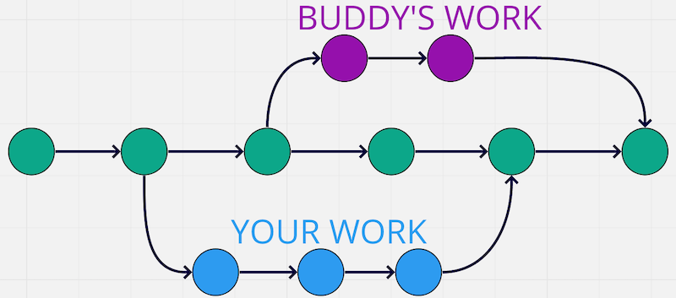
Collaboration on GitHub
Parallelizing With Git
Notes:
We have used Git for the individual purposes of tracking and publishing, but now we'll get down to the
fun social aspect-working and collaborating with others!
Remember, Git and GitHub are not the same thing. You can follow a Git process using another tool as well.

Slide 4

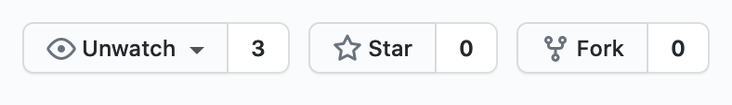
Collaboration on GitHub
GitHub for Sharing Code
Forking copies someone else's repository to your own account.
This kind of code-sharing is normal. Make those forks!
Notes:
So how do we do it? How do we have a group project on GitHub that everyone can edit?
Sometimes, you may want to use code that already exists on GitHub.
<< Refer to LC exercise 1: How do you add someone else's code to your repository? >>

Slide 5
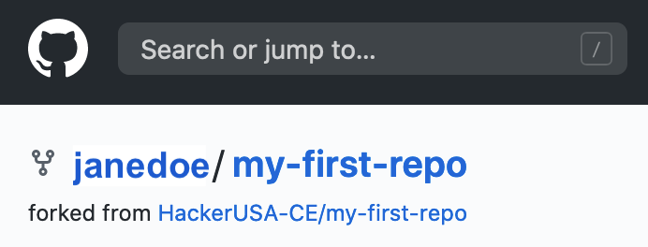
Collaboration on GitHub
GitHub Forks
The base fork is still connected.
Notes:
Forking on GitHub is the process of making a separate copy of someone else's repository to your
own GitHub account. The repos are still linked, so people viewing the repo can tell who the
original author is. You don't have to perform this step if the code is already on your own account.

Slide 6
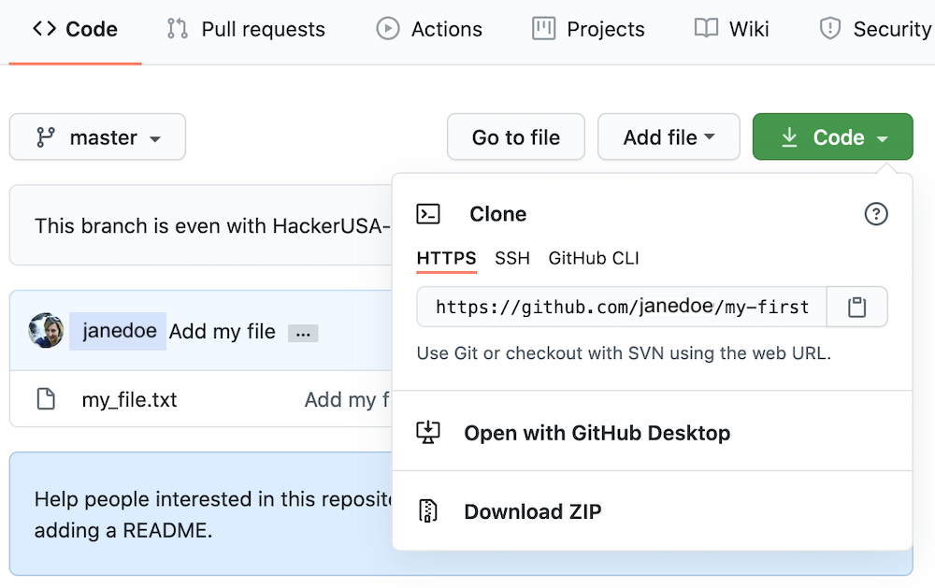
Collaboration on GitHub
Clone from GitHub
The clone link is found on the front page of the repo.
Copy this link!
Notes:
After the fork takes place, you should be redirected to a copy of that repository on your own account.
The clone link on this page is what we'll use so our machines know where they are sending to or
receiving code from.
<< Refer to LC exercise 2: How do you take code from your repository to add to your local machine? >>

Slide 7
Collaboration on GitHub
Clone Command
A clone is a local copy of code you can work on.
Pro-tip: Don't make clones inside of other clones!
Notes:
As you may imagine, you can have any number of clones. This clone command will automatically create a
new folder that defaults to the same name as the repository. You can provide an additional argument
after the clone link if you would like to name the folder otherwise.

Slide 8
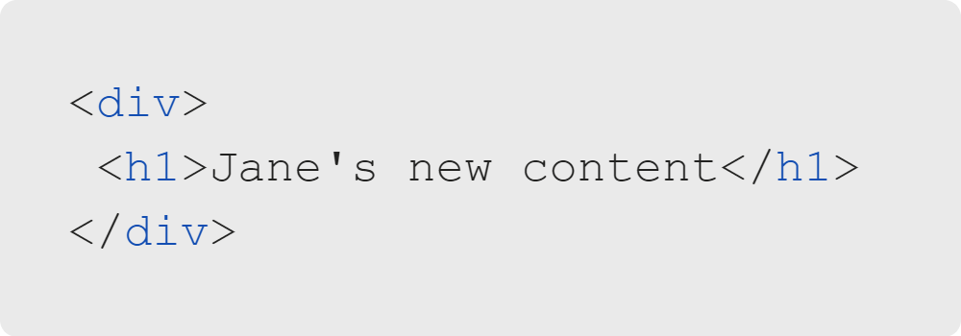
Collaboration on GitHub
Local Changes
Jane can make changes locally.
Create index.html.
Add new items.
Delete items.
Update existing content.
Notes:
Jane can now make changes to her code. She can add new files, delete files, and make changes to those
files. In this case, she adds a file called "index.html" and adds the following HTML markup to it.

Slide 9
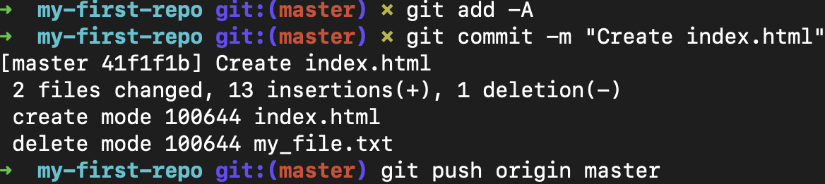
Collaboration on GitHub
Add, Commit & Push
Local changes aren't reflected on GitHub...yet!
The push command will send the changes.
Notes:
Hopefully this process, "add-commit-push" is starting to feel natural!

Slide 10
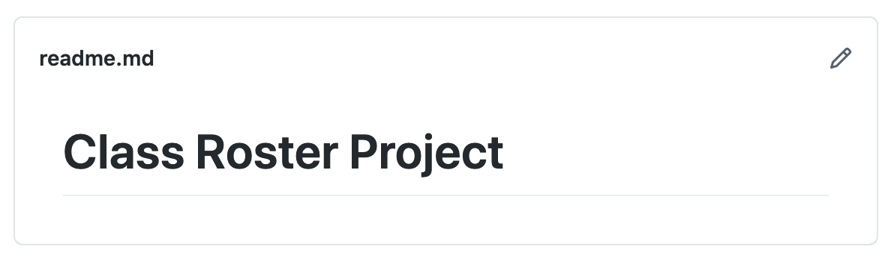
Collaboration on GitHub
Edit on GitHub
Notes:
You may have noticed that you can edit on GitHub directly by clicking that little pencil icon. Be
careful, though! If you do this, your remote repository on GitHub and your local repository on your
machine will be out of sync.

Slide 11
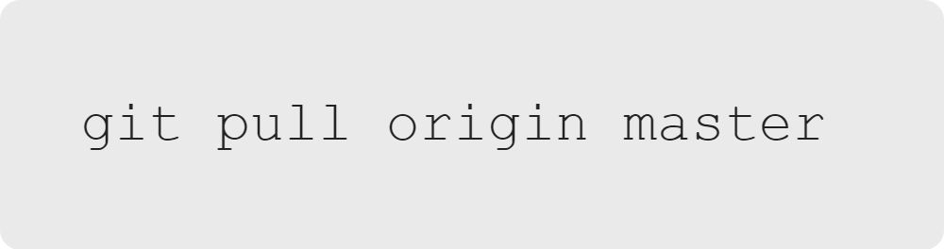
Collaboration on GitHub
Pull from GitHub
The pull command receives changes from GitHub.
Notes:
The answer to syncing up your GitHub and local repositories is the "git pull" command.
Think of this as the opposite of a "git push" command. If "git push" sends code to a
remote address, "git pull" receives code from a remote address.
<< Refer to LC exercise 3: How do you move changes from Github to your local? >>

Slide 12
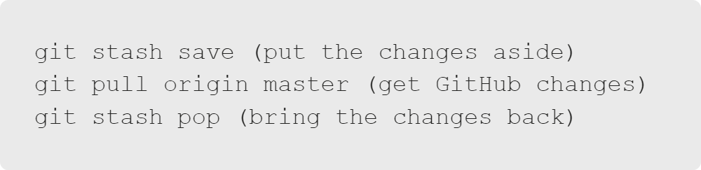
Collaboration on GitHub
Git Stash
What if you have local changes?
We can set them aside or shelve them for a moment while we pull!
Notes:
Git only deals with merging at the commit level. It's not going to touch any changes
that happen outside of a commit.
<< Refer to LC exercises 4 & 5: Git stash save/pop >>

Slide 13
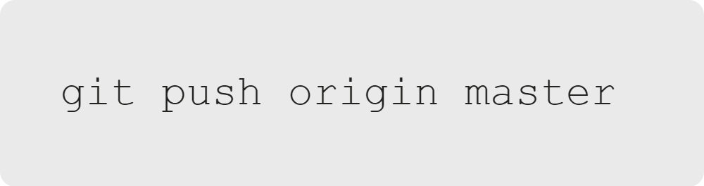
Collaboration on GitHub
Local Automatic Merge
Following your pull command, do another push!
Pull automatically created a commit.
Notes:
"git pull" is shorthand for "git fetch" (getting the changes) and "git merge" (putting the changes together).
If it can, the "pull" command will do an automatic merge, which will need to be pushed back up to GitHub.

Slide 14
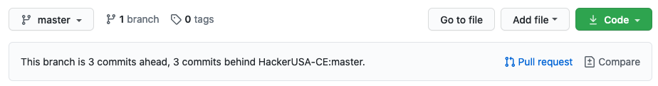
Collaboration on GitHub
Making a Pull Request
Once your GitHub is up to date, you may want to make a pull request.
A pull request is done against the original (base) fork.
Notes:
<< Discuss the purpose of a pull request in context of working as a developer on a team. >>
<< Refer to LC exercise 6: What is the purpose of a pull request? >>

Slide 15


Collaboration on GitHub
Career Readiness
Getting There
Notes:
Let's take a step back for a moment to discuss how to be successful and get the most out of this course.

Slide 16

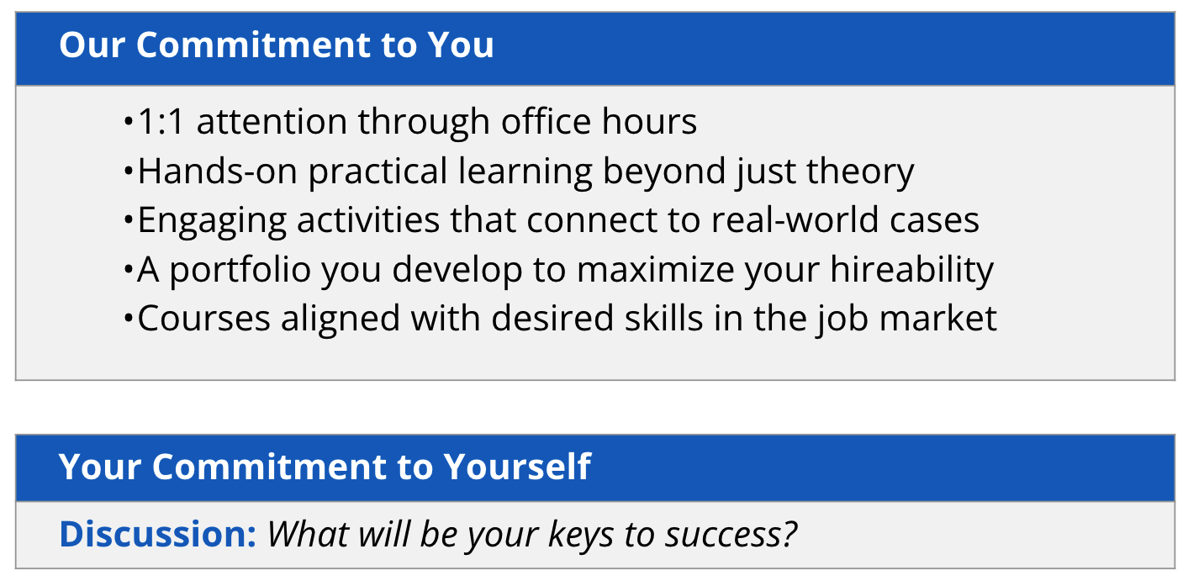
Collaboration on GitHub
Unlock Your Potential
Notes:
The focus of this slide is to encourage learners to commit to this program and invest their efforts by first
listing and expressing the ways in which you (instructor) and the program will support them.
Relating these to career readiness is important. For example, an important tip to succeed in a software development
profession is having a portfolio. Connect to related opportunities students have in the intro class, as well as
throughout the extended program to develop this content.
Make the learner feel that this is a ‘two-way street’ or relationship, so that they engage further with the curricula
and increase their desire to be in this field.
Conduct the discussion before moving to the next slide. Some suggestions include:
- calendar/organization
- attending office hours
- etc.
Refer to the referenced link in the next slide to prepare for this conversation.
Include anecdotes from your own journey as a learner to connect to students and decrease anxieties that they may have.

Slide 17

Collaboration on GitHub
Keys To Success
What does it take?
Make the commitment
No technical skills needed!
Passion for this field
Time to attend class sessions
Curiosity
Willingness to apply in-class material to real life scenarios
Keep things in perspective
Manage your stress
Go to class
Planning and organization
Make it fun
Work consistently
Notes:
Use the list above to help students define their own success plan by discussing the items above and explaining
why they are important, and how to apply them. For example:
- Why is attending class important?
- How can they organize their notes?

Slide 18

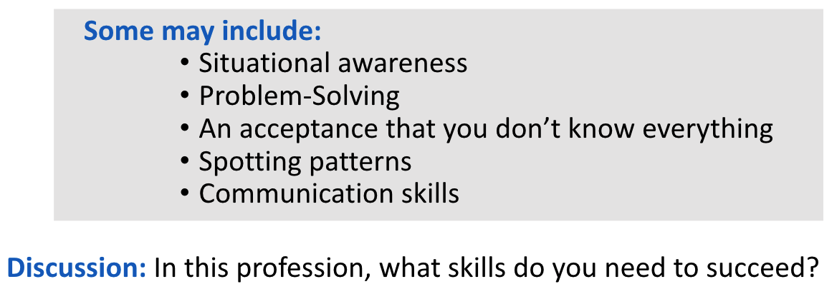
Collaboration on GitHub
You Belong Here
You have what it takes.
As you begin your bootcamp journey, ask yourself: “What abilities and skills do I have already, from prior experience?” Several of your abilities may already match what employers in this field want. Throughout the course, expand these abilities.
Video Clip
Notes:
The focus of this slide is to encourage students to
become more confident with awareness of existing traits that will lead to success and happiness working
in this field. Important: Share stories from the field, including times when you or your company
interviewed candidates, and the importance of technical skills and personality traits that lead to
more success at interviews, as well as more personal satisfaction with the field selected.
<< Video link: https://digitalskills.hosted.panopto.com/Panopto/Pages/Viewer.aspx?id=5981b665-79d1-4f3a-92ce-ae5c015f87e4 >>
Video is a panelist perspectives sharing last pieces of advice specific to starting in the industry to close out the slide.

Slide 19


Collaboration on GitHub
You've Got This
Today we've learned about:
Benefits of using Git & Github
Common actions on Github such as "fork" and "clone"
How working with Github can accommodate collaboration

Slide 20
Collaboration on GitHub
Review & Merge Pull Requests
Let's do a step-by-step activity.
There are quite a few steps to working together on a project with Git.
Grab a partner or two!
Notes:
<< Assign groups of two or three people or allow learners to pick their own partners. >>

